Slide 1


Automating X-Ray Diagnosis using AI Sponsor – IYKA, Inc. Members - - Charu Yadav - Deepak Singhal - Medhavi Pokhriyal - Reza Amini - Sunny Patel

Slide 2

Automating X-Ray Diagnosis using AI
This is a computer aided diagnosis project, targeted at hospitals to automate diagnosis procedures.
The project uses deep learning algorithms such as Convolutional Neural Networks(CNNs) to implement artificial intelligence.
This project focuses on diagnosing the 14 most common types of chest diseases and thus, is capable of reducing the workload of doctors in hospitals.

Slide 3

BUSINESS PROBLEM
Lack of Doctors
For a hospital, it is extremely important to have priority tasks assigned to the doctors. However, due to a lack of doctors, it has become extremely crucial to use their time wisely.
Inefficiency of the Healthcare Processes
Detecting abnormal components in medical imaging is a significant logistical problem for physicians/researchers, hence, the more accurate the detection results, the more efficient process of diagnosis and treatment

Slide 4
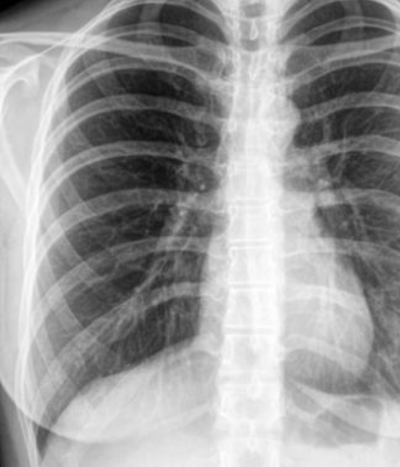
Business Solution
The integration of this product into the clinical system could help health institutions and doctors advance patient care by reducing the time to diagnose.
Efficient Automated X-Ray Diagnosis procedures by using AI prediction models, which will interpret chest X-ray images quickly and more accurately by reducing human prone errors.
The final product of this project would be a high-accuracy model that diagnoses different types of chest diseases when an X-ray image is provided as input.
Also, will help in solving specialist shortage problems in rural areas.

Slide 5
Data Description - I
National Institutes of Health (NIH) Chest X-ray Dataset
Over 112,000 Chest X-ray images from 30,805 unique patients, 45.07 GB of Data
Class descriptions, There are 14 classes (13 diseases, and one for "No findings"). Images can be classified as "No findings" or one or more disease classes:, Atelectasis, Consolidation, Infiltration, Pneumothorax, Edema, Emphysema, Fibrosis, Effusion, Pneumonia, Pleural thickening, Cardiomegaly, Nodule Mass, Hernia
Dataentry2017.csv: Class labels and patient data for the entire dataset, containing image specifications along with Patient age & gender
To mark the pre mentioned labels, they used Natural Language Processing to text-mine disease classifications from the associated radiological reports, have more than 90% accuracy.

Slide 6
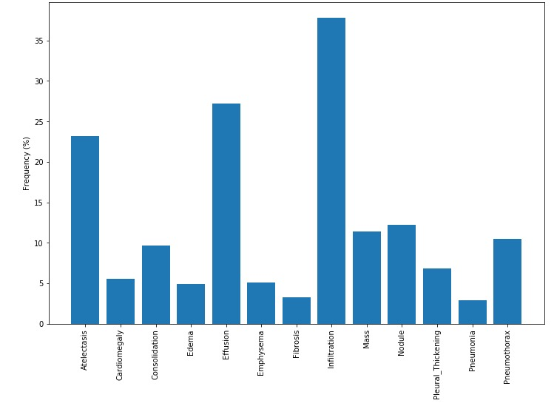
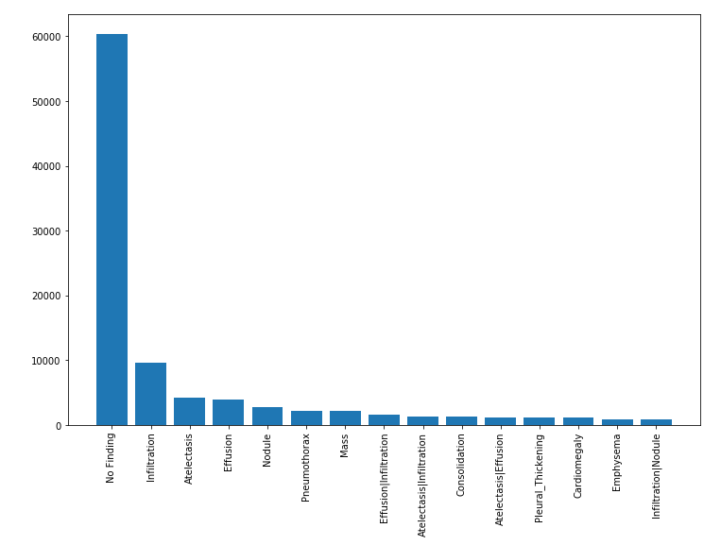
Data Description - II
1. Raw Data has 14 categories including no finding.
2. As a part of EDA, we decided to check the unbiasedness of the data.
3. For unbiasedness, we kept categories that have more than 1000 cases.

Slide 7
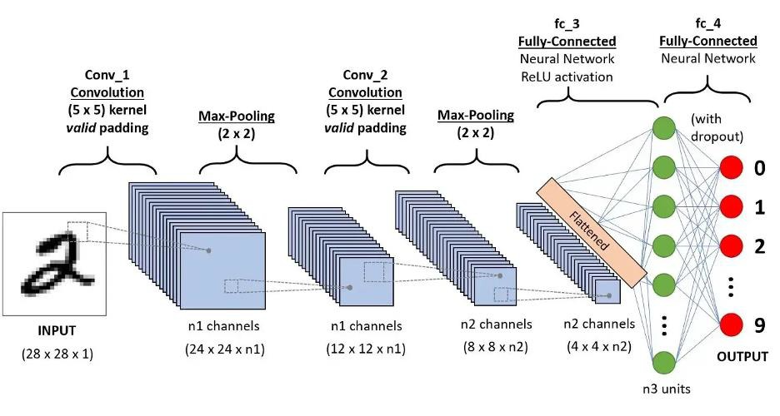
CNN – Convolutional Neural Networks
CNN is a deep-learning algorithm to identify and recognize objects.
CNN is highly suitable for computer vision tasks where object recognition is vital.
The primary purpose of convolution in the case of CNN is to extract features from the input image.
Artificial Neural Network
(Regression & Classification)
Neural Networks
Convolutional Neural Network (Computer vision)
Recurrent Neural Network
(Time Series)

Slide 8
Acceptance Criteria
The Acceptance criteria of an algorithm which can correctly classify the patient’s disease type based on the X-ray image processing.
The algorithm should pass the performance test and show a high accuracy rate including ROC, and AUC.
We will show the algorithm’s efficiency and performance results.

Slide 9
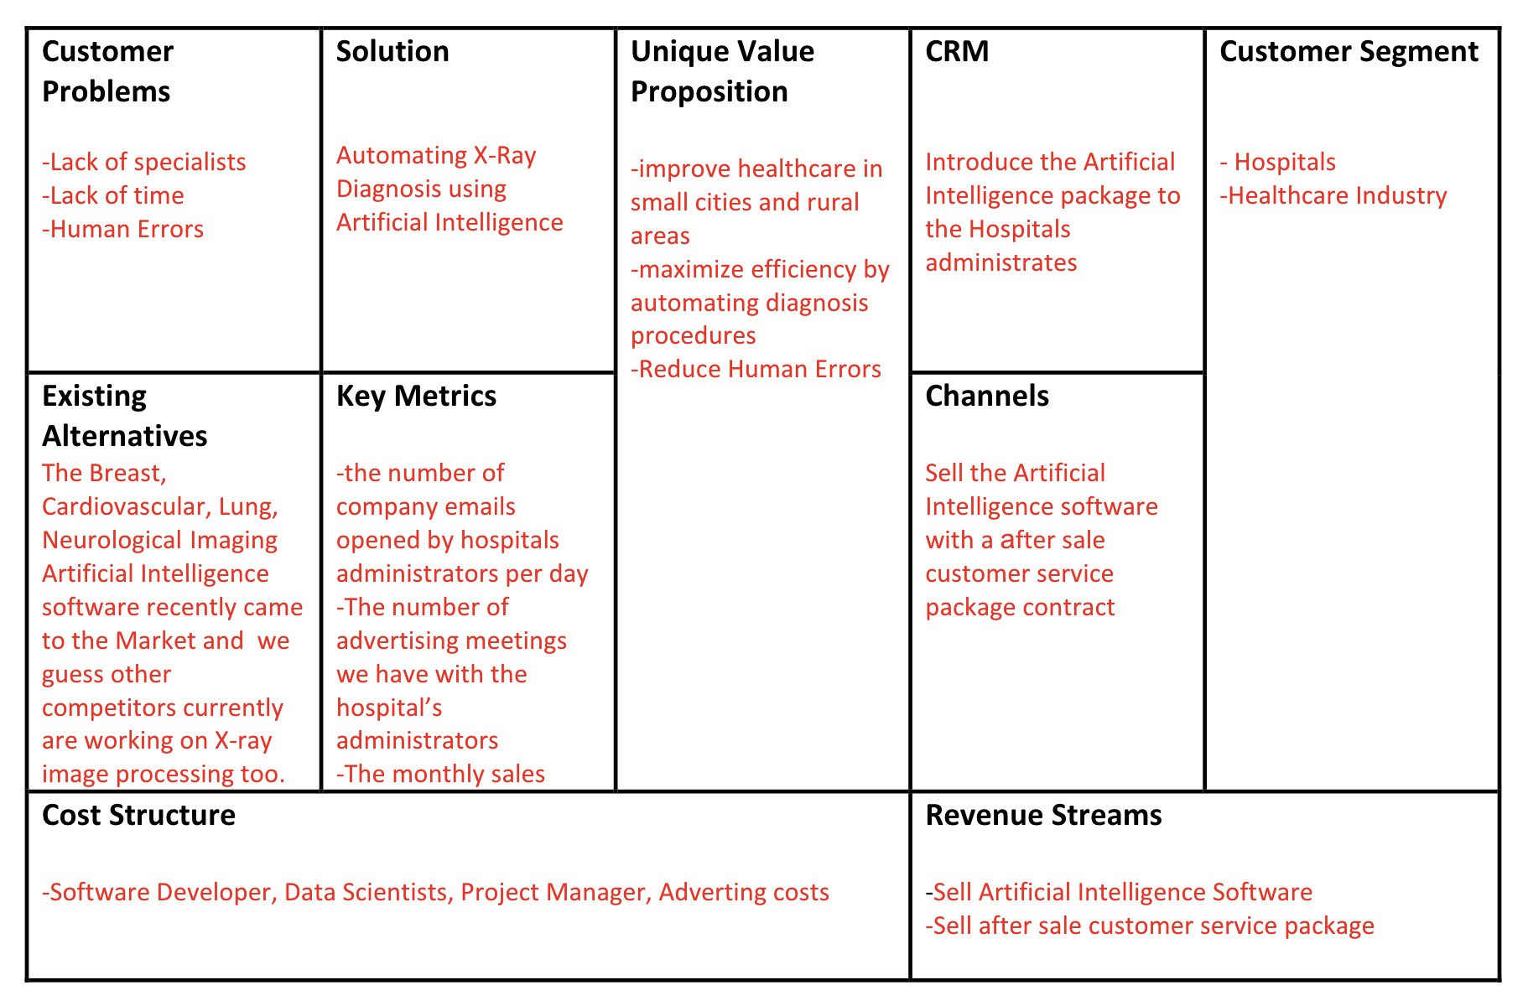
Market Size and Revenue Models

Slide 10

Model Development
Due to a very large dataset, it’s very hard to process this much amount of data in one go. So, we created data generators for loading and randomly transforming images by using a deep-learning library called Keras.
To apply Deep Learning Algorithm, we created a simple model using MobileNet as the base layer, followed by adding a gap layer (such as Dense, Flatten), dropout & fully connected layer.
We used ModelCheckpoint , EarlyStopping, .fit_generator() functions. These are some of the key functions we used for developing our model.

Slide 11
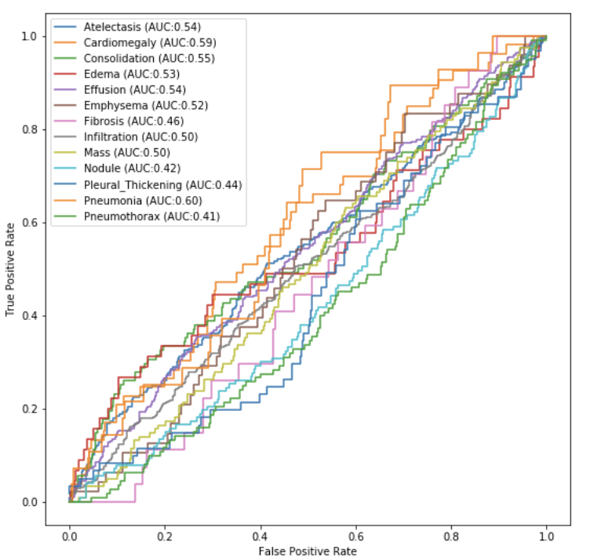
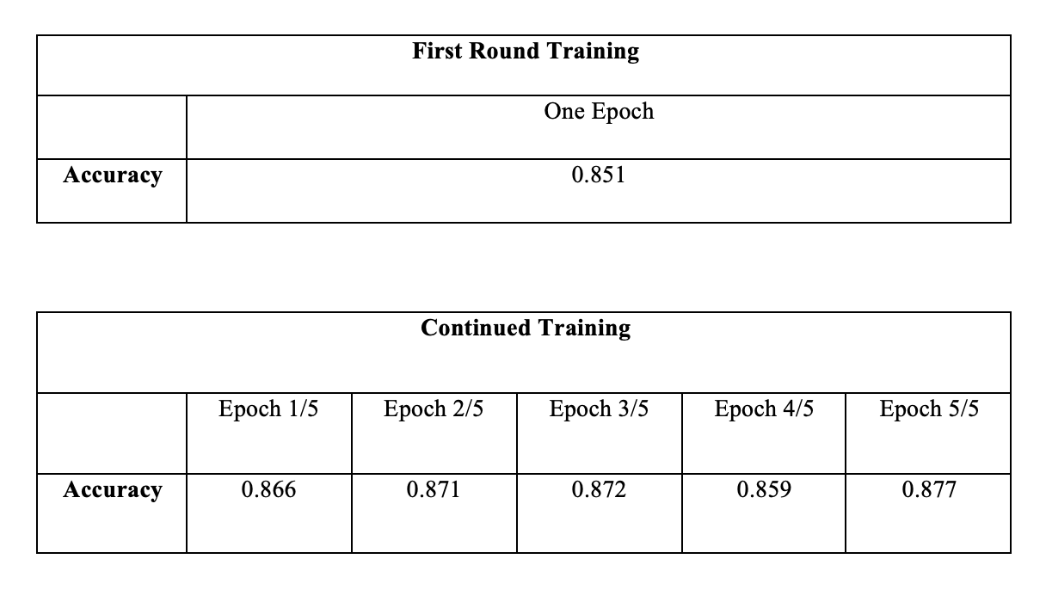
Results

Slide 12
Our Model Comparison with Existing Solution
We gained ~85 % accuracy in the project
High RAM machines or AWS or Google cloud
Optimization techniques (Gradient descent) in code, Include Big Data technology to handle huge datasets

Slide 13

Thank You!

